Slide 1
SWE2315 : Software REQUIREMENTS & DESIGN
Lecture 06: Design
At: CIT Theater
By: 2-4pm

Slide 2
Lecture Outline
Software Design
Acquisition strategy
Architectural Design
Hardware and Software Specification
User Interface

Slide 3
Design
System design is the determination of the overall system architecture consisting of physical processing components, hardware, software, people, and the communication among them that will satisfy the system’s essential requirements
The purpose of the design phase is to decide how to build it.
The design phase is where blueprint for the new system is developed.
The requirements that were identified in the analysis phase serve as the primary inputs for design activities.

Slide 4
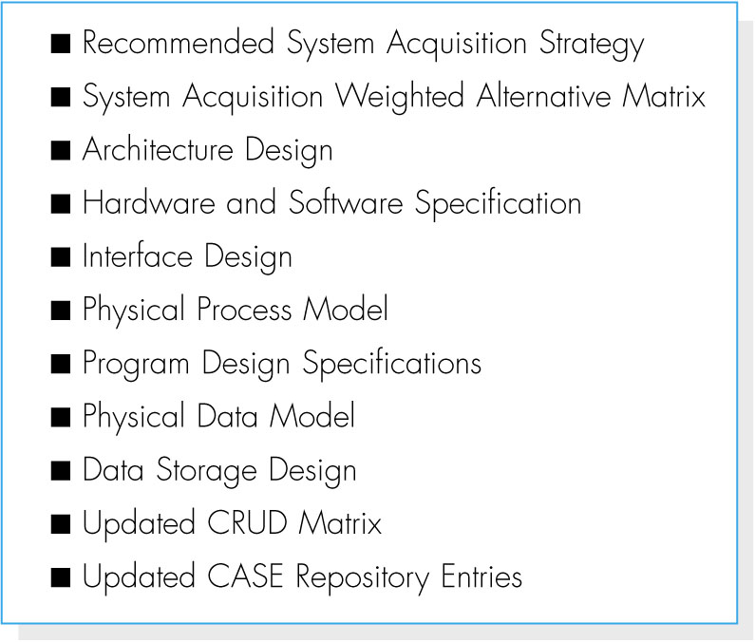
Design Outputs
The main deliverable from the design phase is the system specification.
System specification outline:

Slide 5
Phase 1: System Acquisition Strategy
The project team needs to recommend one of the three (3) approaches to creating the new system
Developing a custom application in-house;
Buying a packaged system and customizing it;
Outsourcing i.e. relying on an external vendor, developer, or system provider to build and/or support the system.

Slide 6
System Acquisition Strategy
Custom development allows developers to be flexible, creative and it builds technical and functional knowledge within the organization.
Customized Software is buying programs that have been created, tested, and proven; Workarounds can be used to meet the needs that are not addressed by the packaged application
Outsourcing is to pay an external service provider to create the system. It does not come without costs and the organization could compromise confidential information or lose control over future development.
Notes:
is used when organization do not have time to devote to a project for which a system is built from scratch.

Slide 7
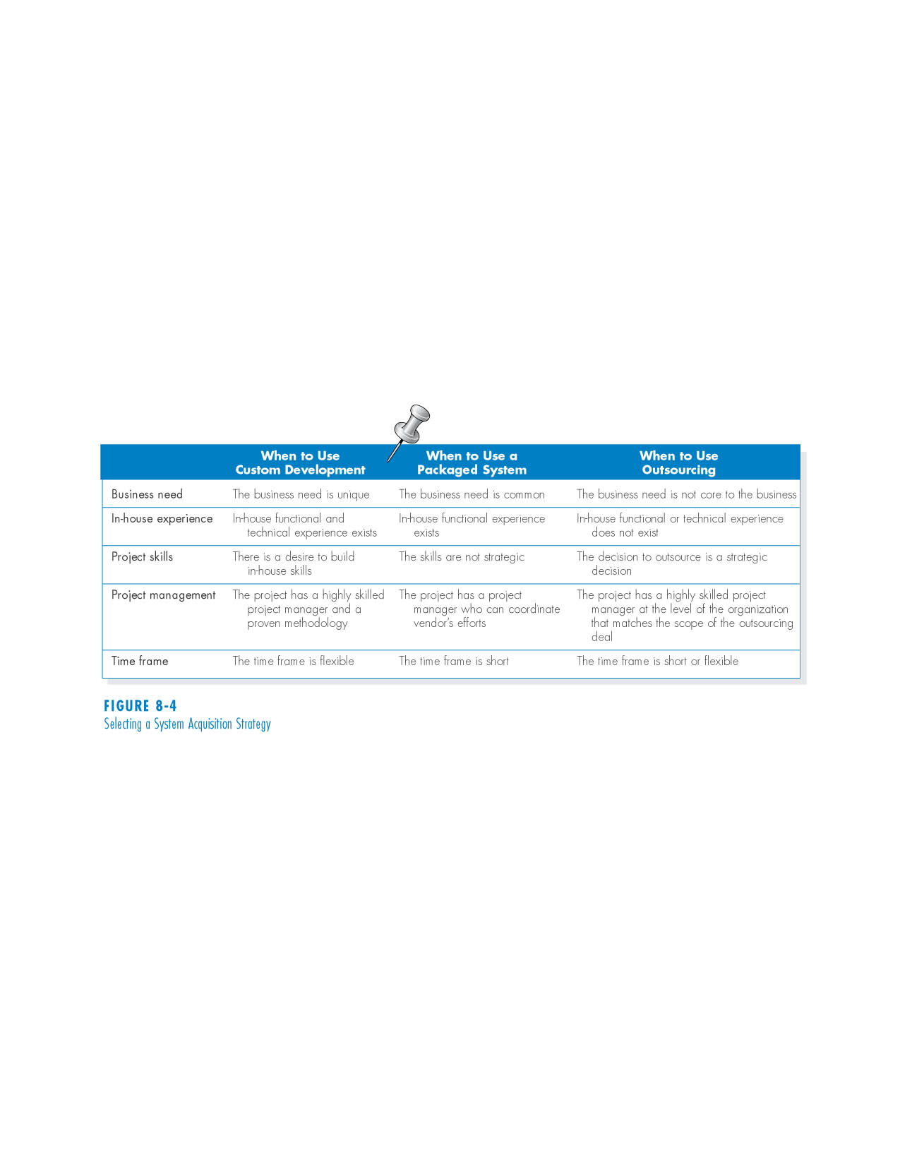
Influences on Acquisition strategies
Project characteristics that influence the choice of acquisition strategy:

Slide 8
Phase 2: Architecture Design
Architecture design
Plans for how the system will be distributed across multiple computers and what hardware, operating system software, and application software will be used for each computer.
Key factors in architecture design
Nonfunctional requirements developed early in the analysis phase play a key role in architecture design.
The major architectural components of any system are the Hardware and the Software.

Slide 9
Hardware Component
- Servers: Larger multi-user computers used to store software and data.
The network: Connects the computers
Client computers: Input-output devices employed by users (e.g., PCs, laptops, handheld devices, smart phones)

Slide 10
Software Component
Data access logic: the processing required to access stored data.
Presentation logic: the display of information to the user and the acceptance of the user’s commands.
Data
storage.
Application logic: the logic documented in the DFDs, use cases, and functional requirements.

Slide 11
Computing Architecture
There are fundamental computing architectures that place these functions on different computers such as Client-server, repository, pipe and filter layered etc.….
Each of the computing architectures has its strengths and weaknesses.
Most organizations are moving to client–server architectures because of their advantages, client–server is generally used today.
A decision on which to use among the client server architecture is made based on the non-functional requirements of the system.

Slide 12
Client Server Architecture
Client–server architectures, attempt to balance the processing between client devices and one or more server devices
In these architectures, the client is responsible for the presentation logic, whereas the server is responsible for the data access logic and data storage.
The application logic may reside on the client, reside on the server, or be split between both

Slide 13
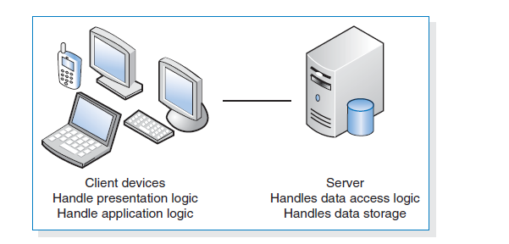
Thin and Thick Client Server Architecture
If the client contained all or most of the application logic, it is called a thick or fat client.
Thin clients, contains just a small portion of the application logic, and are popular because of lower overhead and easier maintenance.
For example, many Web based systems are designed with the Web browser performing presentation and only minimal application logic using such programming languages as JavaScript, while the server side has most of the application logic, all of the data access logic, and all of the data storage.

Slide 14
Advantages of Client Server Architecture
Scalable that means it is easy to increase or decrease the storage and processing capabilities of the servers
Can support many different types of clients and servers. It is possible to connect computers that use different operating systems so that you are not locked into one vendor
for thin client–server architectures that use Internet standards, it is simple to clearly separate the presentation logic, the application logic, and the data access logic and design each to be somewhat independent
If a server fails in a client–server architecture, only the applications requiring that server will fail. The failed server can be swapped out and replaced and the applications can then be restored.

Slide 15
Creating Architecture Design
Creating architecture designs begins with the nonfunctional requirements.
Four primary types of nonfunctional requirements that can be important in designing the architecture:
operational requirements,
performance requirements,
security requirements, and
cultural and political requirements.

Slide 16
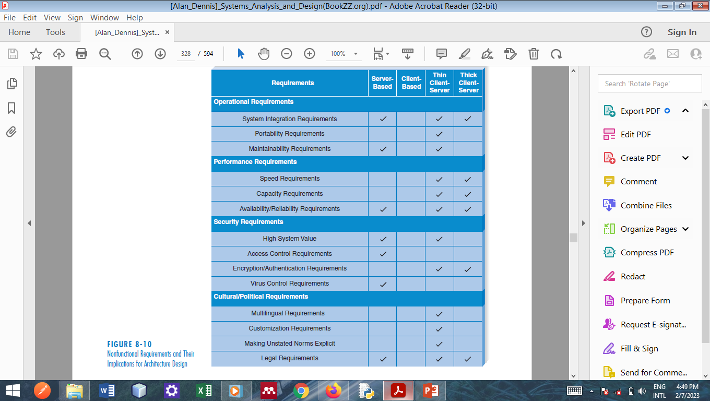
Nonfunctional Requirements and Their Implications for Architecture Design
Notes:
Systems that have extensive
portability requirements tend to be best suited for a thin client–server architecture
because it is simpler to write for Web-based standards (e.g., HTML, XML) that
extend the reach of the system to other platforms than to write and rewrite extensive
presentation logic for different platforms in the server-based, client-based, or
thick client–server architectures.
Client–server architectures that
have multiple servers in each tier should be more reliable and have greater availability,

Slide 17
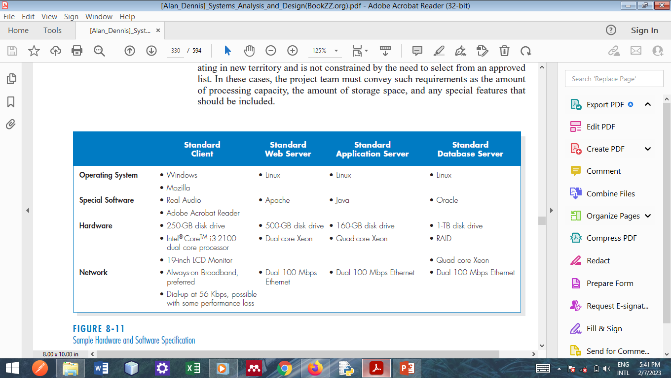
Phase 3: Hardware and Software Specifications
The hardware and software specification is a document that describes what hardware and software are needed to support the application.

Slide 18
Phase 4 : User Interface Design
The user interface design defines the way in which the users will interact with the system and the nature of the inputs and outputs that the system accepts and produces.
The user interface includes three fundamental parts.
Navigation mechanism, the way in which the user gives instructions to the system and tells it what to do (e.g., buttons, menus).
Input mechanism, the way in which the system captures information (e.g., forms for adding new customers).
Output mechanism, the way in which the system provides information to the user or to other systems (e.g., reports, Web pages).

Slide 19
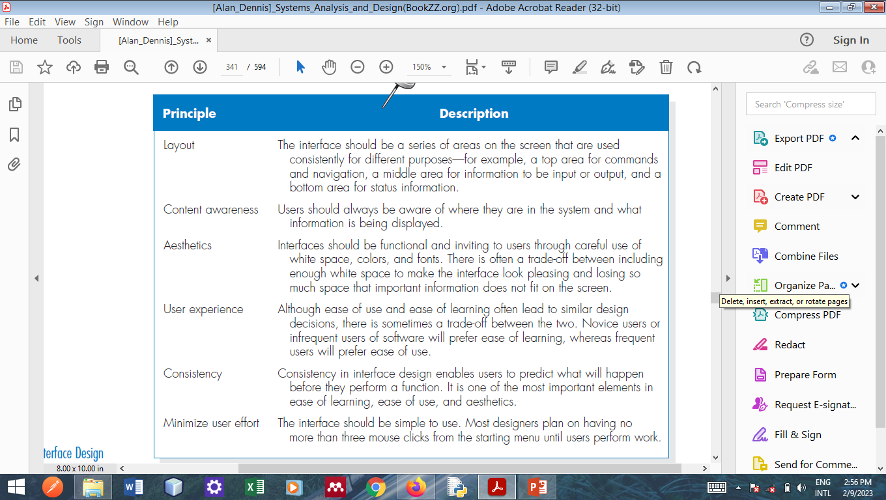
Principle of Interface Design
Goal is to make the interface pleasing to the eye and simple to use, while minimizing the effort users expend to accomplish their work.

Slide 20
Example Interface Design
Consider a Digital Music Download system that allows searching, purchasing and promoting of Tune (Music)
There are three different user interfaces to be designed: Process 1: Search and Browse Tunes; Process 2: Purchase Tunes; and Process 3: Promote Tunes
The first step in the interface design process is to develop the key use scenarios for the Digital Music Download system.
Systems designers for the Digital Music Download system, will examine use cases or DFD and see the types of users and how they would interact with the system.

Slide 21
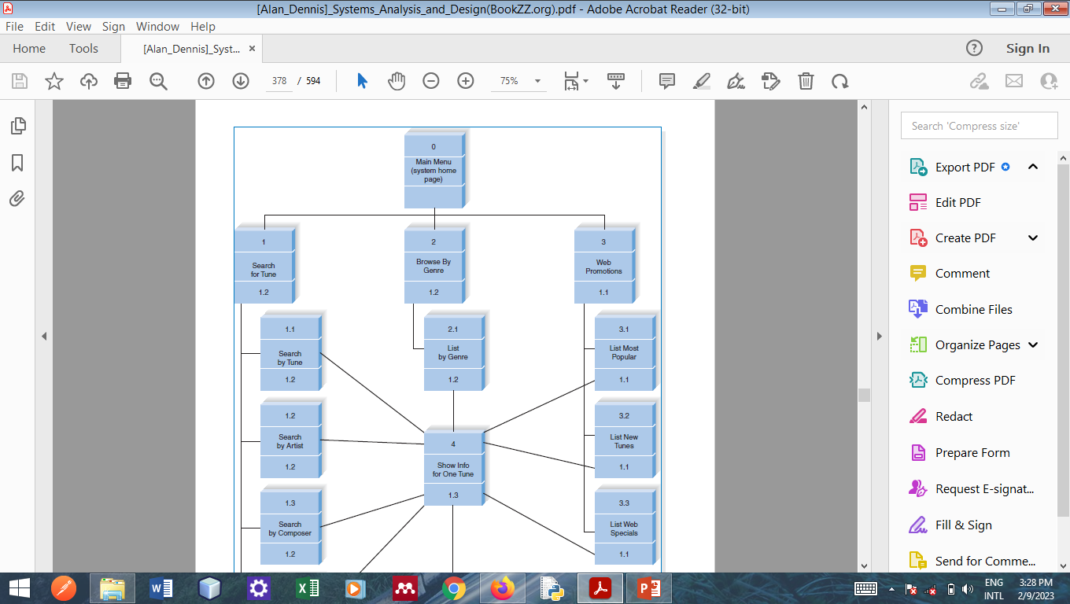
Example - Interface Design Structure

Slide 22
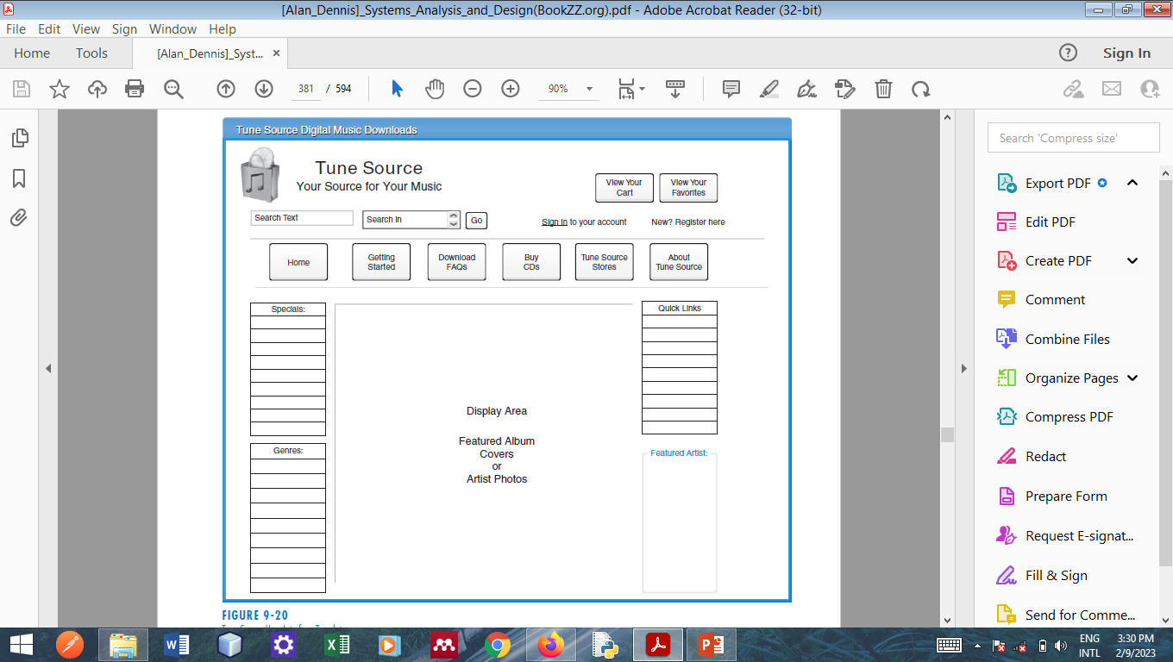
Example - Interface Design Template

Slide 23
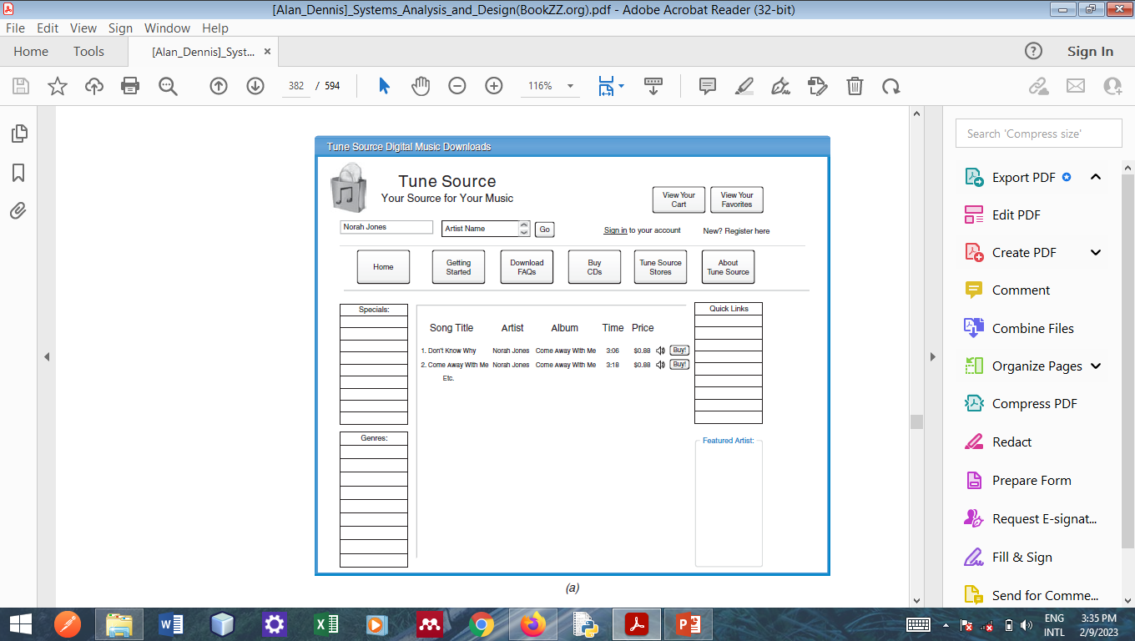
Example- Template Test
Notes:
To make sure it is not crowded.

Slide 24
Group Assignment
Task 6: Design
Choose a system acquisition strategy for your system and state reason for selecting.
Choose an architectural design for your system and state reason for selecting(hint: your non-functional requirements will influence your choice of the architecture).
State the Hardware and Software Specification for your system.
Create a User Design Structure for your System.
Create a User Interface Template for your System.
Task 7: Conclusion
Modify your work plan to include Design subtasks
Merge all Task 1-6 into a single document PDF format and submit on or before 27th February, 2024.

Slide 25
Summary
The design phase is where blueprint for the new system is developed.
The requirements that were identified in the analysis phase serve as the primary inputs for design activities.
The main deliverable from the design phase is the system specification, which includes determine system acquisition strategy, architecture design, hardware and software specifications, interface design, data storage design, and program design.

Slide 26
Questions !!!

